Slide 1
Asexual reproduction in flowering plants
Vegetative propagation

Slide 2
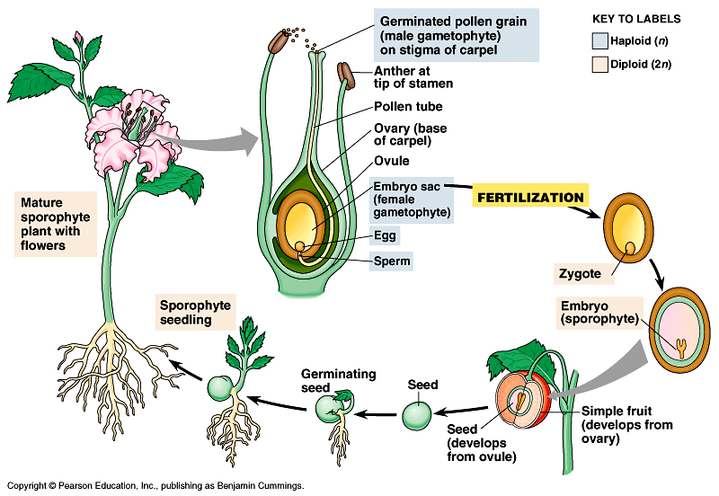
Simplified overview of life cycle of flowering plant
What are the vegetative parts of a plant?

Slide 3
Vegetative propagation in flowering plants
• vegetative parts (e.g. stems, roots & leaves) → new plants
• allows the plants reproduce asexually and to survive in poor conditions

Slide 4
Vegetative propagation in flowering plants
Examples of storage organs :
Tuber
Bulb
Rhizome
Corm
short underground stem with layers of fleshy ‘scale leaves’
e.g. onion bulb
horizontally growing underground stem
e.g. ginger
rhizome
short swollen underground stem
e.g. Gladiolus
corm
Swollen end underground stem
e.g. potato
tuber

Slide 5
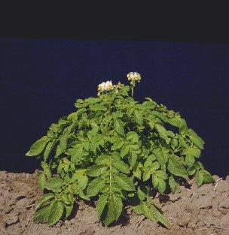
What is this plant?

Slide 6
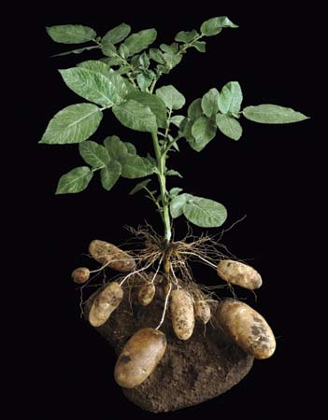
Is potato plant a flowering plant?
From which part of the plant does a potato come?

Slide 7
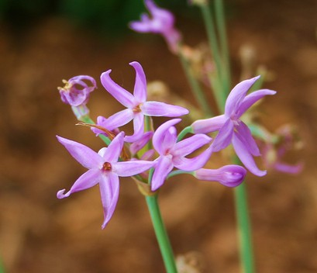
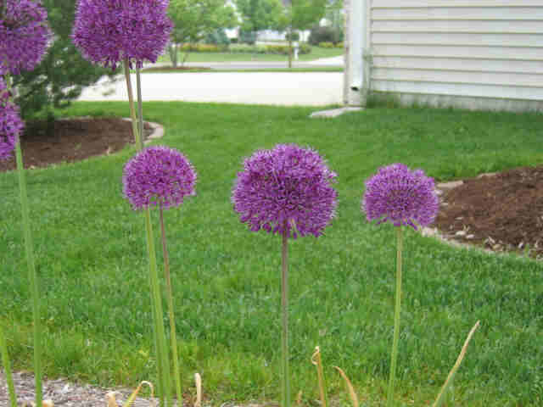
What are these flower?

Slide 8
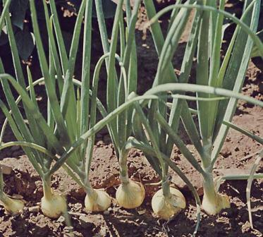

Slide 9
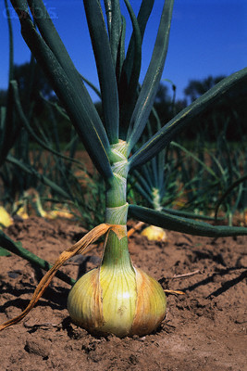
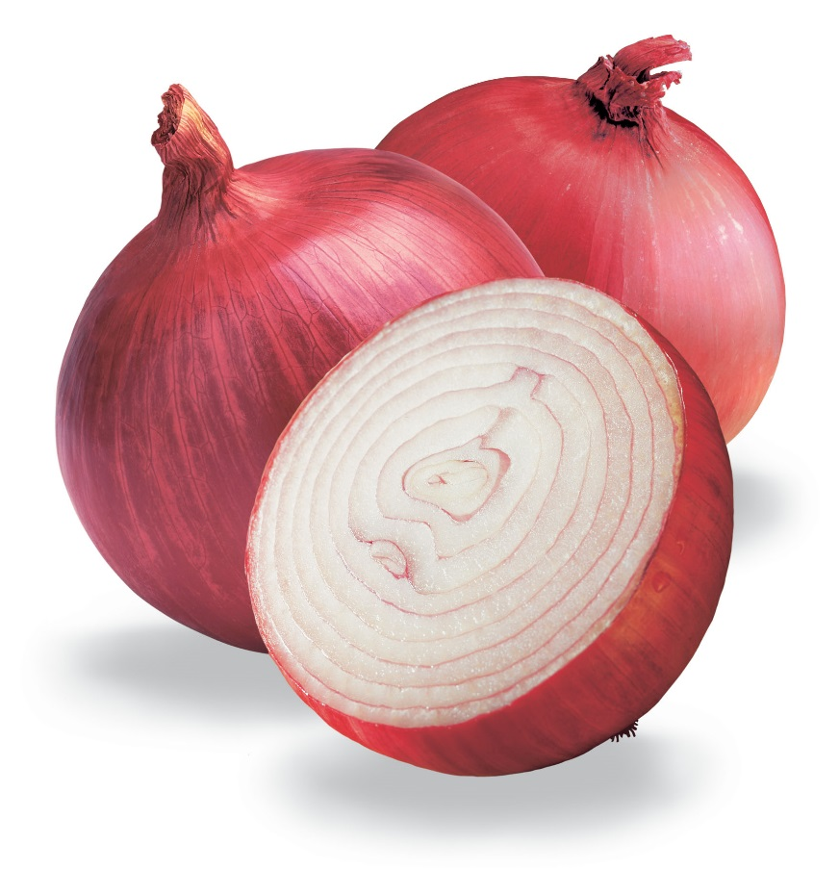

Slide 10
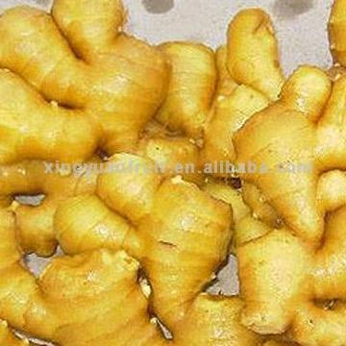
Is ginger a flowering plant?

Slide 11
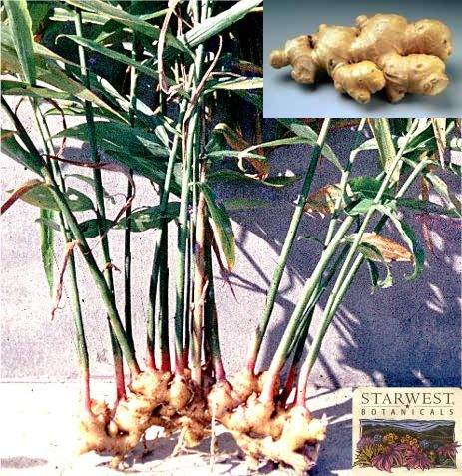
Which part of the plant?

Slide 12
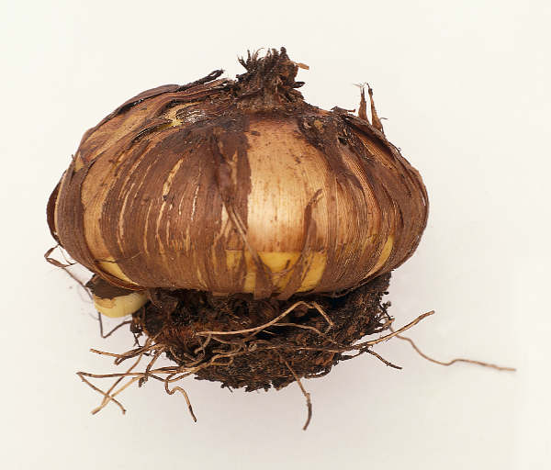
Which part of the gladiolus plant?

Slide 13
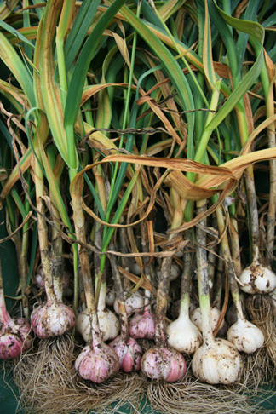
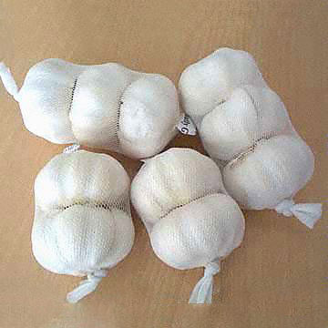

Slide 14
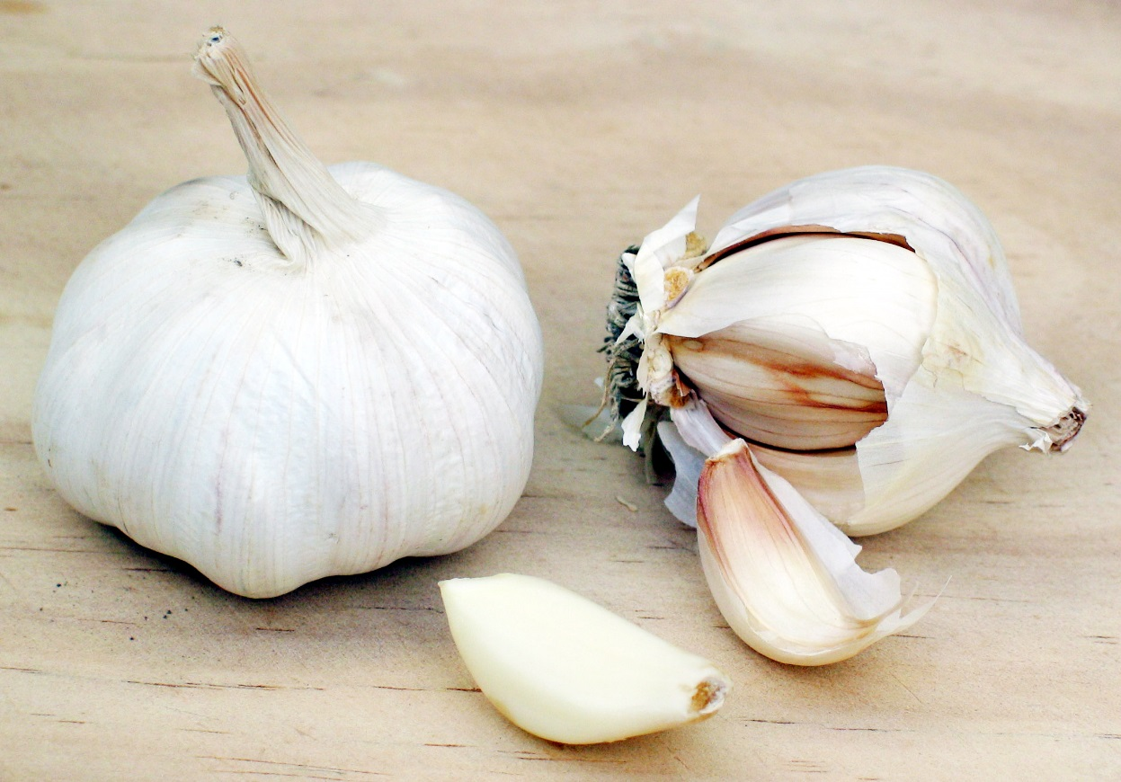
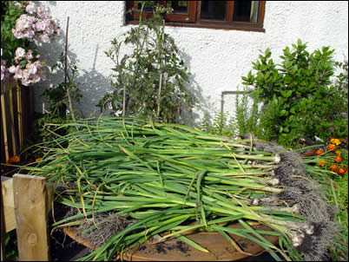

Slide 15
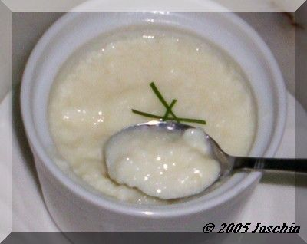
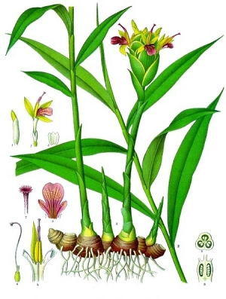
Ginger milk

Slide 16
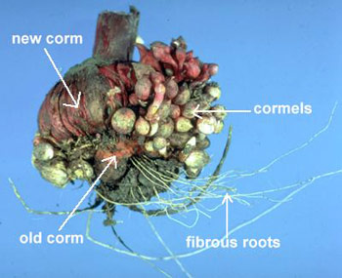
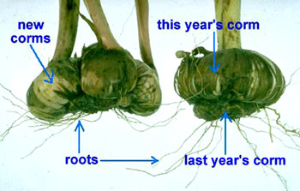

Slide 17
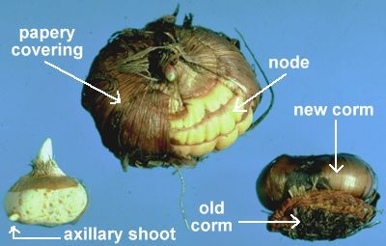

Slide 18
Expert group
Label the following parts in the diagrams:
bud, new plant, food store,old storage organ, new storage organ, adventitious roots
Use red arrows to show how storage food is transported to the developing bud. Use blue arrows to show how food made by the new plant is transported to new storage organs.
Use a flow chart to show five key steps in producing new plants with the storage organs.
(1: aerial part die under unfavourable condition. Storage organ remain dormant underground.)

Slide 19
STAD group
What are the advantages of producing offsprings by underground storage organs.
What are the common problems faced by the offsprings produced in this way.

